Slide 1
CONGESTION CONTROL
GROUP NO 12

Slide 2
WHAT IS CONGESTION?
What is congestion?
The presence of congestion means that the load is greater than the resources(in a part of the network) can handle.
Congestion=load>resources
So, congestion control refers to the techniques used to control or prevent congestion.

Slide 3
Congestion Control Techniques
Open Loop Congestion Control:-These policies are applied to prevent congestion before it happens. The control is handled either by the source or the destination.
Closed Loop congestion:-It is used to treat or alleviate congestion after it happens.

Slide 4
Quality of service(Qos)
What is Qos?
It refers to any technology that manages data traffic to reduce packet loss,latency and jitter on the network.
Qos controls and manages network resources by setting priorities for specific type of data on the network.

Slide 5
Implementing Qos
Best effort:- The model where all the packets receive the same priority and there is no guaranteed delivery of packet
Integrated services:-It is a QoS model that reserves bandwidth along a specific path on the network
Differentiated Services :- It is a model which deals with multiple classes of traffic with different priorities.

Slide 6
MULTIPROTOCOL LABEL SWITCHING
(MPLS)

Slide 7
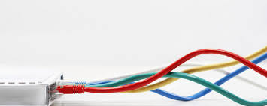
INTRODUCTION
1. When an internet router receives an packet, that packet carries no information beyond a destination IP address. There is no instruction on how that packet should get to its destination or how it should be treated along the way.
2. Each router has to make an independent forwarding decision for each packet based solely on the packet’s network-layer header. Thus, every time a packet arrives at a router, the router has to “think through” where to send the packet next. The router does this by referring to complex routing tables.
3. The process is repeated at each hop along the route until the packet eventually reaches its destination. All of those hops and all of those individual routing decisions result in poor performance for time-sensitive applications like video-conferencing or voice over IP (VoIP).

Slide 8
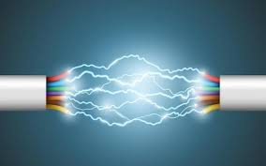
WHAT IS MPLS?
Multi-protocol label switching (MPLS), it was launched in the late 1990s, addresses these problems by establishing pre-determined, highly efficient routing.
The beauty of MPLS is that it’s not tied to any underlying technology. This means it does protocol independent routing.
It assigns label to every packet and uses that label as index in different intermediate routers between ingress and egress routers, for fast transmission and less “think through” process.

Slide 9
HOW IT is IMPLEMENTED?
1. With MPLS, the first time a packet enters the network, it is assigned to a specific forwarding equivalence class (FEC), indicated by appending a short bit sequence (the label) to the packet.
2. Each router in the network has a table indicating how to handle packets of a specific FEC type, so once the packet has entered the network, routers don’t need to perform header analysis. Instead, subsequent routers use the label as an index into a table that provides them with a new FEC for that packet.
3. Either it will push a new FEC, or swap with new FEC or pop an FEC from the label. According to the table stored in the router.
4. This whole process is done till there is no FEC in the label and that means that the packet has reached it’s destination.

Slide 10
MPLS LABEL
00 | 01 | 02 | 03 | 04 | 05 | 06 | 07 | 08 | 09 | 10 | 11 | 12 | 13 | 14 | 15 | 16 | 17 | 18 | 19 | 20 | 21 | 22 | 23 | 24 | 25 | 26 | 27 | 28 | 29 | 30 | 31
Label |  |  |  |  |  |  |  |  |  |  |  |  |  |  |  |  |  |  |  | QoS |  |  | BoS | TTL: Time-to-Live
The MPLS Label consists of four sub-parts:
The Label: The label holds all of the information for the MPLS routers to determine where the packet should be forwarded.
Experimental: Experimental bits are used for Quality of Service (QoS) to set the priority that the labeled packet should have.
Bottom-of-Stack: The Bottom-of-Stack(BoS) tells the MPLS Router if it is the last leg of the journey and there are no more labels to be concerned with. This usually means the router is an egress router.
Time-To-Live: This identifies how many hops the packet can make before it is discarded.

Slide 11
MOBILE IP

Slide 12
KEY TERMS
Home network : The home network of a mobile device is the network within which the device receives its identifying IP address
Home address : The home address of a mobile device is the IP address assigned to the device within its home network.
Foreign network : A foreign network is the network in which a mobile node is operating when away from its home network.
Care-of address : The care of address of a mobile device is the network-native IP address of the device when operating in a foreign network.

Slide 13
KEY TERMS(Contd.)
Home agent : A home agent is a router on a mobile node’s home network which tunnels datagrams for delivery to the mobile node when it is away from home. It maintains current location (IP address) information for the mobile node. It is used with one or more foreign agents.
Foreign agent : A foreign agent is a router that stores information about mobile nodes visiting its network. Foreign agents also advertise care-of-addresses which are used by Mobile IP.

Slide 14
KEY MECHANISMS IN MOBILE IP:
AGENT DISCOVERY
AGENT REGISTRATION
TUNNELING

Slide 15
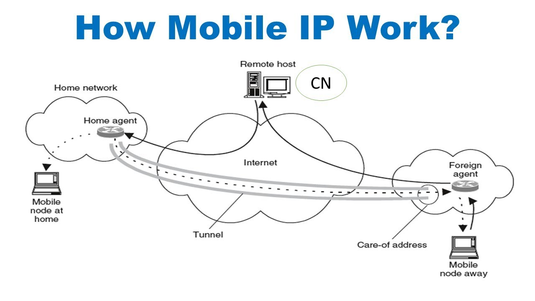

Slide 16
Mobile adhoc Network
(MANET)

Slide 17
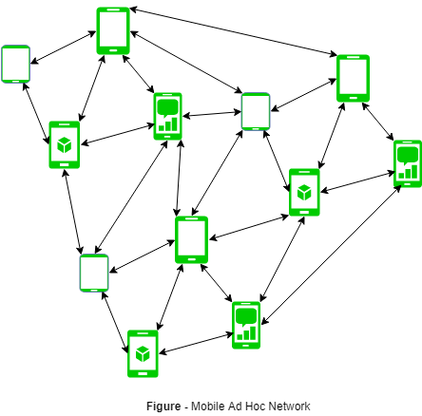
MANET
MANET stands for Mobile adhoc Network also called as wireless adhoc network
-Set of mobile nodes connected wirelessly in self configured network.
MANET may operate:
> standalone fashion
> larger internet.

Slide 18
About MANET
The main challenge for the MANET:
continuously maintain information required to properly route traffic.
Consists of peer-to-peer, self-forming network,MANET’s circa 2000-2015 typically communicate at radio frequencies (30MHz-5GHz).
Used in road safety, ranging from sensors for environment, home, health, disaster rescue operations, air/land/navy defense, weapons, robots, etc.

Slide 19
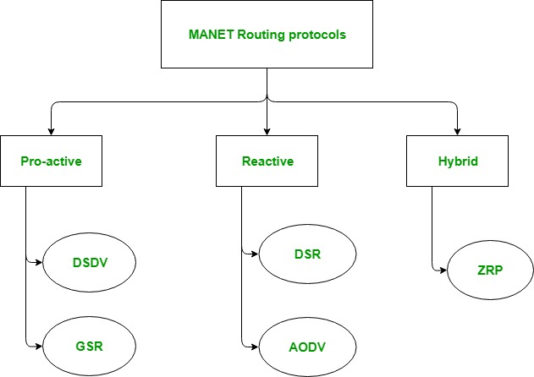
MANET ROUTING PROTOCOL
--dynamic topology.
--basic rules is that a new node whenever enters into an ad-hoc network, must announce its arrival and presence and should also listen to similar announcement broadcasts made by other mobile nodes.

Slide 20
MANET
MANET stands for Mobile adhoc Network also called as wireless adhoc network
-Set of mobile nodes connected wirelessly in self configured network.
MANET may operate:
> standalone fashion
> larger internet.

Slide 21
MANET(contd)..
The main challenge for the MANET:
-continuously maintain information required to properly route traffic.
Consists of peer-to-peer, self-forming network,MANET’s circa 2000-2015 typically communicate at radio frequencies (30MHz-5GHz).
Used in road safety, ranging from sensors for environment, home, health, disaster rescue operations, air/land/navy defense, weapons, robots, etc.

Slide 22
MANET ROUTING PROTOCOL
--dynamic topology.
--basic rules is that a new node whenever enters into an ad-hoc network, must announce its arrival and presence and should also listen to similar announcement broadcasts made by other mobile nodes.

Slide 23
Dynamic Source Routing protocol (DSR)
Reactive/On demand
Based on Source Routing
Phases of DRS protocol
Route Discovery
RREQ packet ( Route Request packet) (Broadcast)
RREP packet ( Route Reply packet ) (Unicast)
RERR message ( Route Error message)
Route Maintenance
Route Cache

Slide 24
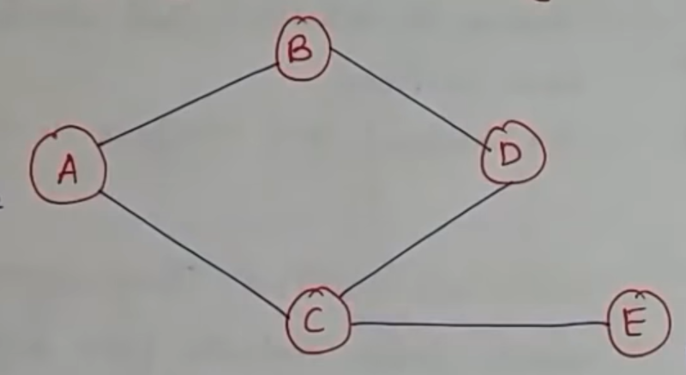

RREQ packet
General form
Broadcast
Source -> Destination
Example
<Unique ID> | <Source address> | <Destination address>
source
RREQ packet
destination

Slide 25
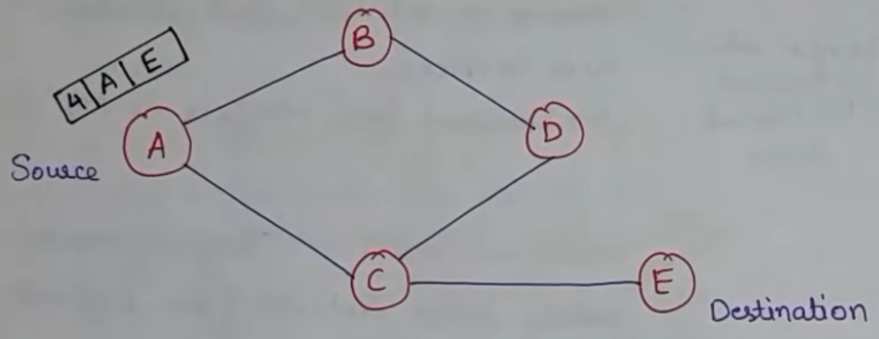

RREP packet
General form
Unicast
Destination -> Source
Example
<Unique ID> | <Source address> | <Destination address> | <Path>
RREQ packet

Slide 26

RERR packet
General form
Unicast
Faulty Router -> Source
Example
<Path>
source
RREQ packet
Broken Link

Slide 27
Example of DSR (route discovery)

Slide 28

Example of DSR (route discovery)

Slide 29

Example of DSR (route discovery)

Slide 30

Example of DSR (route discovery)

Slide 31
Example of DSR (route discovery)

Slide 32

Example of DSR (route discovery)
Accepted
Rejected
Route Discovery done

Slide 33
Example of DSR (route Maintenance)
Route Maintenance done

Slide 34
Example of DSR (Route Cache)
Route Cache

Slide 35
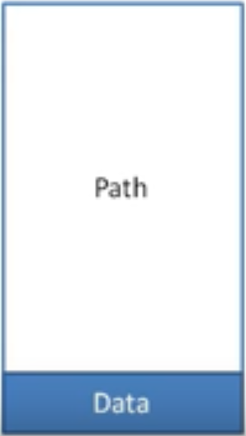
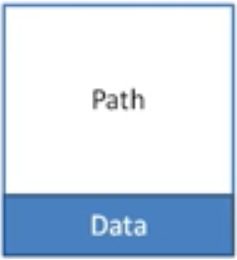
Disadvantages of DSR
Path is stored in Data
As network size grow, length of path increases
After increasing Network size

Slide 36
Ad-Hoc On Demand Vector Routing protocol (AODV)
Extension of DSR
DSR stores path in the data packet’s header
AODC stores the path in the routing table
Operates in two phases
Route discovery
Route maintenance

Slide 37
Ad-Hoc On Demand Vector Routing protocol (AODV)
Every node stores two counters
Timestamp
Unique ID
REQQ packet
REQP packet
<Source address> | <Source Timestamp> | <Unique ID of node> | <Destination address> | <Destination Timesamp> | <hop count>
<Source address> | <Destination address> | <Destination Timesamp> | <hop count> | <lifetime>

Slide 38
SERVICES
Finding a cost function that is most suitable for routing in MANET.
Earlier the use of MANET was too limited.
provide proper support for deployment of multimedia applications(delay and sensitive).
Soft real time application:
-voice telephony, video on demand, video conferencing.
MILITARY purposes(air/land/navy defense):
MANET connects soldier in battle field, vehicles
6. Disaster relief during an emergency situation-network infrastructure is down or non-existent.
so here MANET is set up….

Slide 39
Thankyou!

